Slide 1




Powered by

Slide 2

SCOPE
QMS Format
Program
  Page Layout and 1st Page Header
  2nd Page Header
  Components
Form
  Content
  Change History
  Standard Worksheet

Slide 3
PART 1
Program
Page Layout and 1st Page Header

Slide 4
PAGE LAYOUT
Program
Font style, size and color | Arial, 11 (for header); Arial, 10 (for the body), Justify; Black text
Line Spacing | Before and after: 0”; 1.15 spacing
Paper Size | 8.5” x 11” (US Letter)
Page Margins | Top, sides, bottom 0.75”
Header/Footer Margins | 0.5”

Slide 5
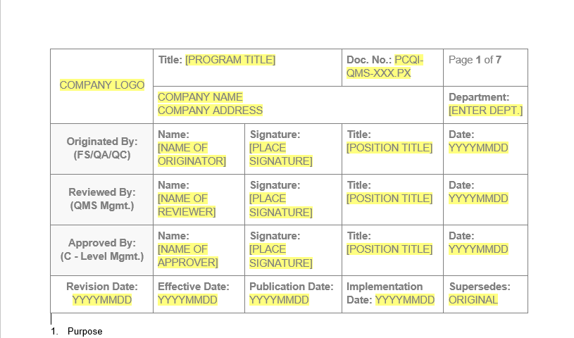
1ST PAGE HEADER
Program
Copy and paste the CIG PX header template inside the header section.
Table Tools > Layout > AutoFit window

Slide 6
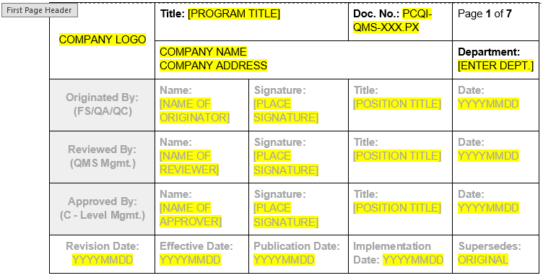
1ST PAGE HEADER
Program
1. Company Logo:
a) Not altered/warped.
b) Should fit in the box.
2. Title:
a) Based on the standard or regulation used.
3. Doc. No.:
a) Company Initials-QMS-XXX.PX
4. Company Name and Address:
a) Based on the legal Enterprise details
5. Page Number:
a) Insert > Page Number > Current Position > Set to "Page X of Y"
6. Department:
a) Compliance

Slide 7
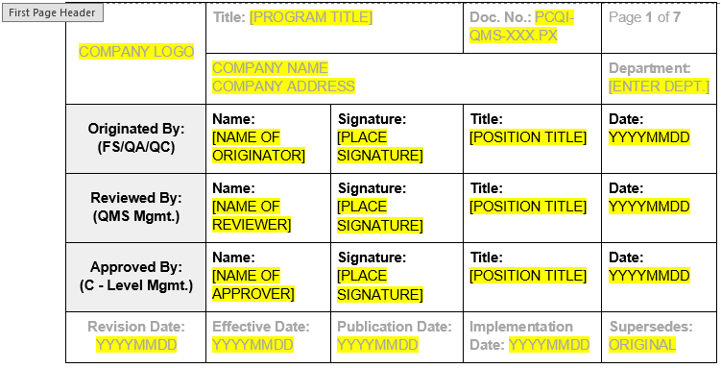
1ST PAGE HEADER
Program
1. Originated by:
Name: Arnel Ryan
Signature: Arnel's electronic signature
Title: PCQI
Date: Current date
2. Reviewed by:
a) Based on the designated personnel of the Enterprise.
3. Approved by:
Based on the designated personnel of the Enterprise.
4. Date:
a) Format in YYYYMMDD

Slide 8
1ST PAGE HEADER
Program
1. Originated by:
Document Originator – FS/QA/QC Personnel
a) Creates or revises documents.
b) Ensures the implementation of document control systems.
c) Identifies the need for new documents or modifications to existing approved versions.
2. Reviewed by:
Reviewer – QMS Management
a) Reviews documents or their revisions for accuracy and implementation.
b) Recommends final approval, disapproval, or revision of documents.
c) Ensures resources are available to meet the requirements specified in the documents.
3. Approved by:
Approver – Senior Management/Company Officer
a) Holds final approval authority.
b) Represents the company's acceptance of liability.
c) Ensures funds and resources are available to meet the requirements specified in the documents.

Slide 9
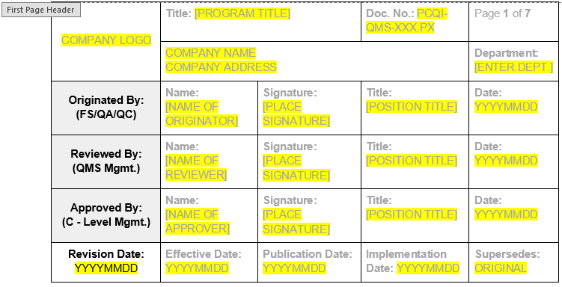
1ST PAGE HEADER
Program
Originated by: (FS/QA/QC)
Reviewed by: (QMS Mgmt.)
Approved by: (C-Level Mgmt.)
Revision Date:
Font: Bold, Align Center
Table Layout:
Align Center (text is horizontally and vertically centered within the cell)

Slide 10
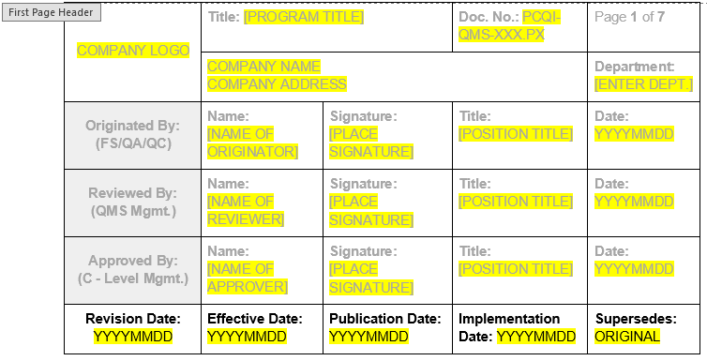
1ST PAGE HEADER
Program
1. Revision Date:
a) "Originated by" and "Revision Date" should be the same.
b) Revision Date = Current Date.
2. Effective Date:
a) The date the document is signed and approved.
3. Publication Date:
a) The date the document is published and distributed to initiate training.
4. Implementation Date:
a) The date the document is distributed and the training is completed.
5. Supersedes:
a) ORIGINAL – initial issuance of the document
b) Last Revision Date – for nth number of revision/s

Slide 11
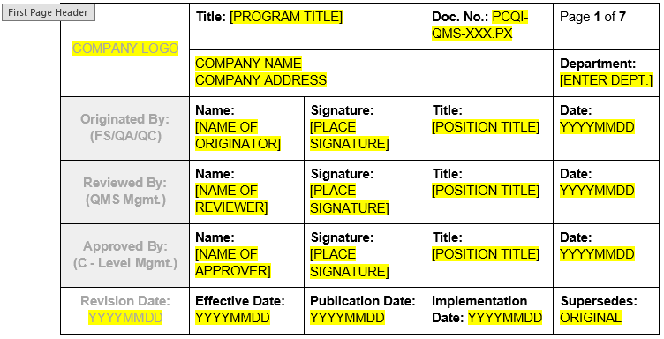
1ST PAGE HEADER
Program
Table Layout:
Align Top Left (text is aligned to the top left corner of the cell)

Slide 12
PART 1
Program
2nd Page Header

Slide 13
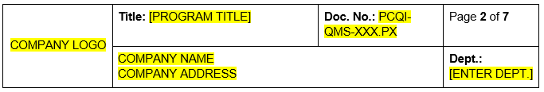
2ND PAGE HEADER
Program
1. Company Logo:
a) Not altered/warped.
b) Should fit in the box.
2. Title:
a) Based on the standard or regulation used.
3. Doc. No.:
a) Company Initials-QMS-XXX.PX
4. Company Name and Address:
a) Based on the legal Enterprise details
5. Page Number:
a) Insert > Page Number > Current Position > Set to "Page X of Y“
6. Dept.:
a) Compliance

Slide 14
2ND PAGE HEADER
Program
Company Logo
Align Center (image is horizontally and vertically centered within the cell.)
Image set at ‘In line with text’
Title:
Doc. No.:
Company Name and Address
Page Number
Dept.: (abbreviation)
Table Layout:
Align Top Left (text is aligned to the top left corner of the cell)

